Slide 1


Lecture 2: Data
What it is, where to get it, and factors to consider.
Harvard IACS
CS109B
Pavlos Protopapas, Kevin Rader, and Chris Tanner

Slide 2
Learning Objectives
Understand different types and formats of data
Be able to soundly select appropriate data
Have awareness of biases that exist
Be able to refine questions to suite your true inquiry
Understand how to parse text with regular expressions

Slide 3
Agenda
What is data?
Aspects of data: formats, scope, biases, etc
Asking precise questions
Parsing data with Regular Expressions

Slide 4
Agenda
What is data?
Aspects of data: formats, scope, biases, etc
Asking precise questions
Parsing data with Regular Expressions

Slide 5
What is data?
Notes:
- Data exists independently from our wanting to do science with it

Slide 6
What is data?
Def₁
Factual information (such as measurements or statistics) used as a basis for reasoning, discussion, or calculation
Def₂
Information in digital form that can be transmitted or processed
Def₃
Information output by a sensing device or organ that includes both useful and irrelevant or redundant information and must be processed to be meaningful

Slide 7
What is data?
Def₁
Factual information (such as measurements or statistics) used as a basis for reasoning, discussion, or calculation
Def₂
Information in digital form that can be transmitted or processed
Def₃
Information output by a sensing device or organ that includes both useful and irrelevant or redundant information and must be processed to be meaningful

Slide 8
What is data?
Def₁
Factual information (such as measurements or statistics) used as a basis for reasoning, discussion, or calculation
Def₂
Information in digital form that can be transmitted or processed
Def₃
Information output by a sensing device or organ that includes both useful and irrelevant or redundant information and must be processed to be meaningful

Slide 9
Factual information (such as measurements or statistics) used as a basis for reasoning, discussion, or calculation
Scenario₁
Measurements from a thermometer every hour for a year
Scenario₂
Counts from a person who tracks the days that a particular hummingbird visits his birdfeeder across an entire year
Scenario₃
Tweets from a politician
Scenario₄
Readouts from a mysterious sensor that was purchased from a local yard sale.

Slide 10
Factual information (such as measurements or statistics) used as a basis for reasoning, discussion, or calculation
Scenario₁
Measurements from a thermometer every hour for a year
Probably inaccurate data
Scenario₂
Counts from a person who tracks the days that a particular hummingbird visits his birdfeeder across an entire year
Scenario₃
Tweets from a politician
Probably missing data
Probably missing data
Scenario₄
Readouts from a mysterious sensor that was purchased from a local yard sale.

Slide 11
Factual information (such as measurements or statistics) used as a basis for reasoning, discussion, or calculation
Scenario₁
Measurements from a thermometer every hour for a year
Scenario₂
Counts from a person who tracks the days that a particular hummingbird visits his birdfeeder across an entire year
Scenario₃
Tweets from a politician
Probably not 100% factually true
Scenario₄
Readouts from a mysterious sensor that was purchased from a local yard sale.

Slide 12
Factual information (such as measurements or statistics) used as a basis for reasoning, discussion, or calculation
Scenario₁
Measurements from a thermometer every hour for a year
Scenario₂
Counts from a person who tracks the days that a particular hummingbird visits his birdfeeder across an entire year
Scenario₃
Tweets from a politician
Don’t know what it represents. Just numbers. Still data.
Scenario₄
Readouts from a mysterious sensor that was purchased from a local yard sale.

Slide 13
What is data?
Datum
A single piece of information, which can be treated as an observation
Data
The plural of datum; multiple observations
Dataset
A homogenous collection of data (each datum must have the same focus)

Slide 14
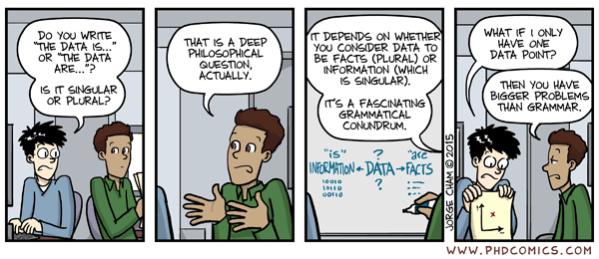
What is data?
Source: http://phdcomics.com/comics/archive_print.php?comicid=1816

Slide 15
What is data?
Everything can be data! Just requires making observations.

Slide 16
Before we dive too deep into the different aspects of data, recall the Data Science process
Ask an interesting question
Get the Data
Explore the Data
Model the Data
Communicate/Visualize the Results
Notes:
Mention the scientific process. You learn more, you adapt.

Slide 17
Before we dive too deep into the different aspects of data, recall the Data Science process
Ask an interesting question
Get the Data
Explore the Data
Model the Data
Communicate/Visualize the Results

Slide 18
Before we dive too deep into the different aspects of data, recall the Data Science process
Ask an interesting question
Get the Data
Explore the Data
Model the Data
Communicate/Visualize the Results

Slide 19
Before we dive too deep into the different aspects of data, recall the Data Science process
Ask an interesting question
Get the Data
Explore the Data
Model the Data
Communicate/Visualize the Results

Slide 20
Before we dive too deep into the different aspects of data, recall the Data Science process
Ask an interesting question
Get the Data
Explore the Data
Model the Data
Communicate/Visualize the Results

Slide 21
Before we dive too deep into the different aspects of data, recall the Data Science process
Ask an interesting question
Get the Data
Explore the Data
Model the Data
Communicate/Visualize the Results

Slide 22
Before we dive too deep into the different aspects of data, recall the Data Science process
Ask an interesting question
Get the Data
Explore the Data
Model the Data
Communicate/Visualize the Results

Slide 23
Before we dive too deep into the different aspects of data, recall the Data Science process
Ask an interesting question
Get the Data
Explore the Data
Model the Data
Communicate/Visualize the Results

Slide 24
Before we dive too deep into the different aspects of data, recall the Data Science process
Ask an interesting question
Get the Data
Explore the Data
Model the Data
Communicate/Visualize the Results

Slide 25
Before we dive too deep into the different aspects of data, recall the Data Science process
Extra Credit Knowledge: computer science mostly concerns computational models and related aspects (e.g., what is computable, how to efficiently compute, how to efficiently store data for computing)
Ask an interesting question
Get the Data
Explore the Data
Model the Data
Communicate/Visualize the Results

Slide 26
Agenda
What is data?
Aspects of data: formats, scope, biases, etc
Asking precise questions
Parsing data with Regular Expressions

Slide 27
Agenda
What is data?
Aspects of data: formats, scope, biases, etc
Asking precise questions
Parsing data with Regular Expressions

Slide 28
Considerations when choosing a dataset
We want data that can answer our question(s) and is preferably easy to work with.
Data comes in all shapes and sizes though.

Slide 29
Considerations when choosing a dataset
What data is necessary to answer our question?
How difficult is it to analyze a dataset?
Is the source authoritative? (.com, .net, .org, .gov, .name)
Comprehensive data vs sampled data?
Biases
What is the allowed usage of data under its license?
Who collected the data?
When was the data collected?
How was the data collected?
How is the data formatted?
Does your data collection procedures need to be approved by an IRB?
Confidentiality Concerns

Slide 30
Considerations when choosing a dataset
What data is necessary to answer our question?
How difficult is it to analyze a dataset?
Is the source authoritative? (.com, .net, .org, .gov, .name)
Comprehensive data vs sampled data?
Biases
What is the allowed usage of data under its license?
Who collected the data?
When was the data collected?
How was the data collected?
How is the data formatted?
Does your data collection procedures need to be approved by an IRB?
Confidentiality Concerns

Slide 31
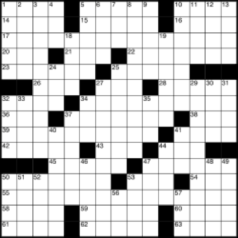
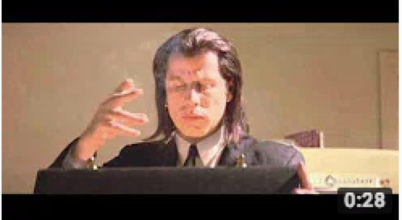
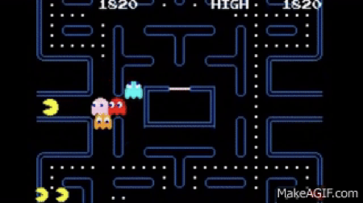

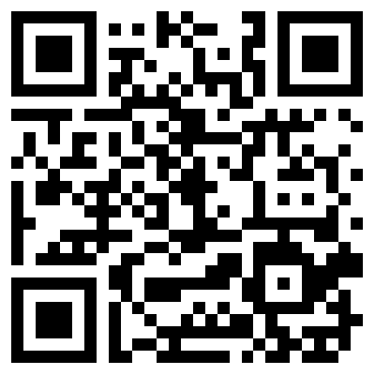
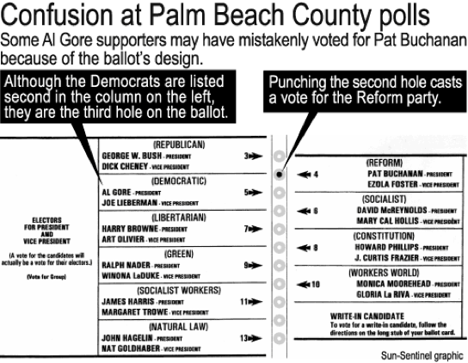
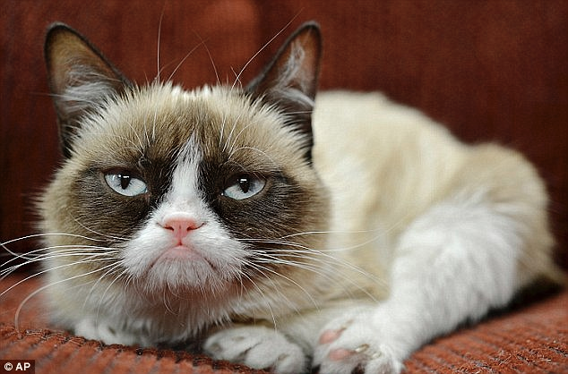
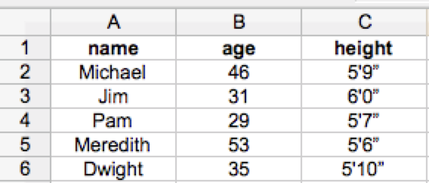
Considerations when choosing a dataset: format difficulty
hard for computers
easy for computers
easy for people
hard for people

Slide 32



Considerations when choosing a dataset: comprehensive data
Have access to all the data observations that exist, which is usually a lot
Collected and digitized as part of generalized procedures of an institution
13 million articles
~500 million tweets per day
100,000s votes per year

Slide 33

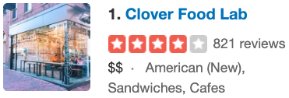


Considerations when choosing a dataset: sampled data
When collecting individual data is relatively expensive
Only a portion of the population is sampled
Not just restricted to polling or surveys

Slide 34
Considerations when choosing a dataset: biases
Common biases in selecting the source of data
Omission: Using only arguments from one side
Source selection: Include more sources or more authoritative sources for one side over the other
Story selection: Regularly including stories that agree or reinforce the arguments of one side
Placement: Using the benefit of the perceived importance of position to highlight certain stories

Slide 35
Considerations when choosing a dataset: biases
Common biases in selecting the source of data
Labelling (two types):
Using only arguments from one side
Labeling people on one side of the argument with labels and not the other
Spin: Story provides only one interpretation of the events

Slide 36
Considerations when choosing a dataset: biases
Common biases in the data itself (i.e., sampled datasets)
A bias in sampled data occurs when a procedure causes the sample to overrepresent a subpopulation
Biases may not necessarily be intentional
Even if you don’t think your over-/ under-representation of a subpopulation will impact your results, it’s still a bias
Always strive to minimize any biases in your data collection procedures

Slide 37
Considerations when choosing a dataset: biases
Gallup Polls
Randomly calls two groups of ~500 people a day by sampling among all possible phone numbers
For landlines, asks for household member who has the next birthday
Calls people living in all 50 states
Tries to assure 70% cellphone, 30% landlines
Weights data to reflect the demographics of the general population

Slide 38
Considerations when choosing a dataset: biases
IMDb Movie Ratings
Registered users rate films 1-10 stars; they are an overrepresented subpopulation relative to the general population
Registered users who rate movies in their free time further over represents a specific segment of the general population
“Men Are Sabotaging The Online Reviews Of TV Shows Aimed At Women¹”
60% who rated Sex in the City were women. Women gave it a 8.1, men gave it 5.8.
¹ fivethirtyeight.com

Slide 39
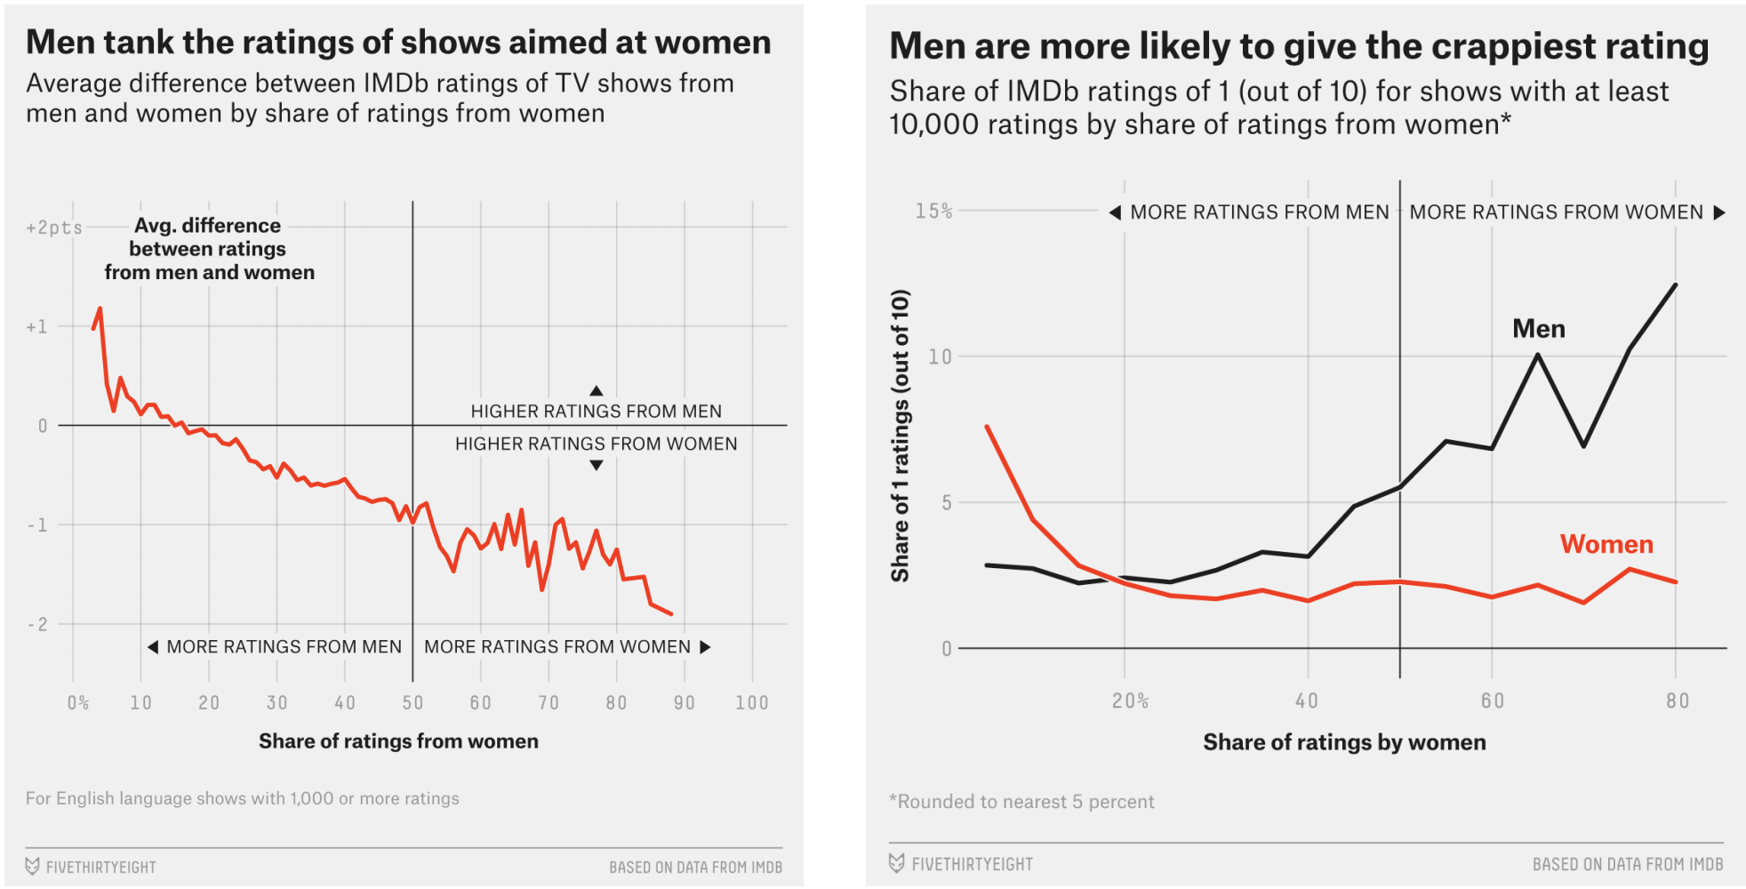
Considerations when choosing a dataset: biases
IMDb Movie Ratings

Slide 40
Considerations when choosing a dataset: biases
Yelp Reviews
Registered users rate businesses on a 1-5 star scale
Registered users tend to represent a certain subset of the population (those who are more social media inclined and opinionated)
Customers with extreme experiences are more likely to voice their opinions

Slide 41
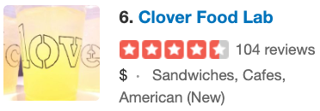
Considerations when choosing a dataset: biases
Yelp Reviews

Slide 42
Considerations when choosing a dataset: biases
Yelp Reviews
Longwood Medical
Harvard Square

Slide 43
Considerations when choosing a dataset: biases
Nearly all datasets involve a human in some way or another, and our world is far from being uniform and equal. This is not an excuse but evidence that your dataset probably has bias. The goal is to minimize it as much as possible.
When we learn about modelling, the same applies.

Slide 44
Considerations when choosing a dataset: formats
While computers are getting better at ‘understanding’ photos and videos, text and numbers are much easier.
Further, structured data (e.g., spreadsheet formatted data) is much easier than unstructured data (e.g., free-flowing essays)

Slide 45

Considerations when choosing a dataset: formats
Plain Text
ALICE’S ADVENTURES IN WONDERLAND
Lewis Carroll
THE MILLENNIUM FULCRUM EDITION 3.0
CHAPTER I. Down the Rabbit-Hole
Alice was beginning to get very tired of sitting by her sister on the bank, and of having nothing to do: once or twice she had peeped into the book her sister was reading, but it had no pictures or conversations in it, ‘and what is the use of a book,’ thought Alice ‘without pictures or conversations?’
Ends in .txt (generally)
No formatting, font type, font size, color, etc.
Text position is provided by whitespace characters (space, tab, return)

Slide 46
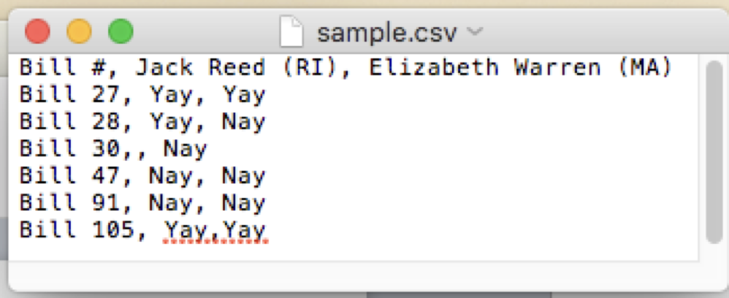
Considerations when choosing a dataset: formats
Plain Text
CSV (.csv)
Tab-separated (.tsv)
Delimiter: The character that separates each value

Slide 47
Considerations when choosing a dataset: formats
XML
XML (.xml)
These colors ——> aren’t actually stored in the file, the editor just adds them on your screen to help make it look prettier
<roll_call_vote>
<congress>115</congress>
<session>1</session>
…
<members>
<member>
<member_full>Alexander (R-TN)</member_full>
<last_name>Alexander</last_name>
<first_name>Lamar</first_name>
<party>R</party>
<state>TN</state>
<vote_cast>Yea</vote_cast>
…
</member>
</members>
</roll_call_vote>

Slide 48
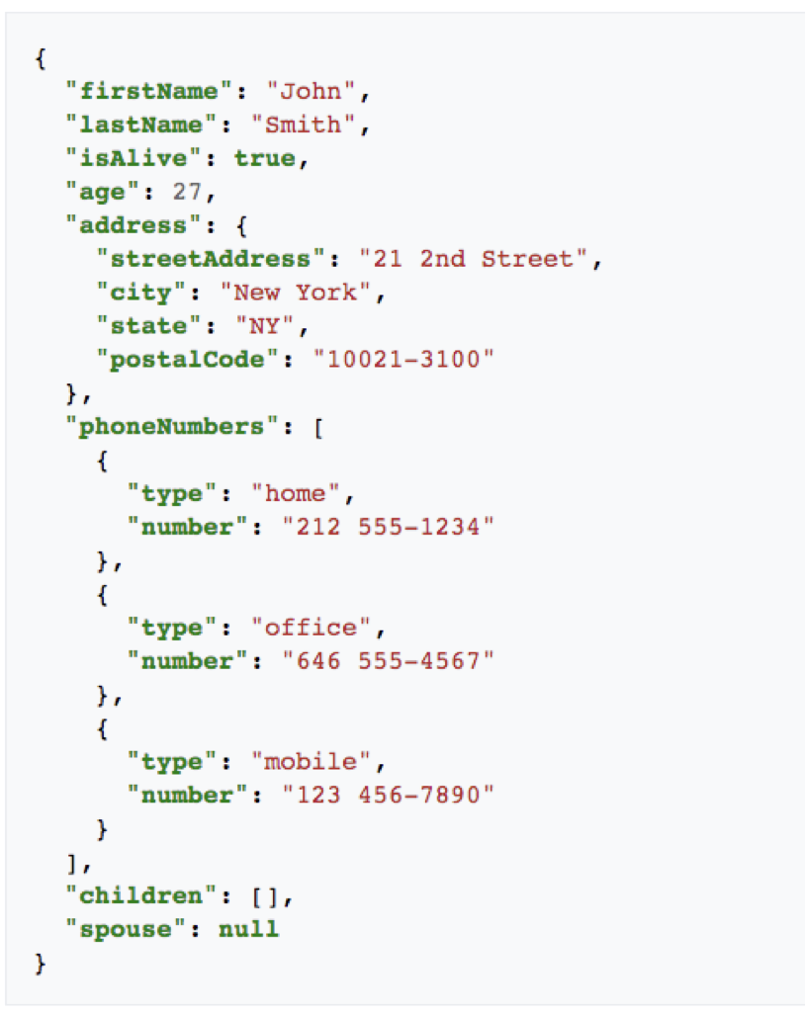
Considerations when choosing a dataset: formats
JSON
JSON (.json)
JavaScript Object Notation
Like XML, data is annotated
A nesting of key-value pairs
When whitespace is removed, can be more space efficient than XML

Slide 49
Considerations when choosing a dataset: formats
Plain Text vs XML vs JSON
They can all express the same content
Plain Text doesn’t have structure, but is universally robust
XML is the most verbose, harder to parse
JSON doesn’t have </stuff_here> end tags
JSON is more succinct than XML (easier to parse)

Slide 50
It’s important to re-evaluate your previous steps to ensure you’re on the right track
Ask an interesting question
Get the Data
Explore the Data
Model the Data
Communicate/Visualize the Results

Slide 51
Agenda
What is data?
Aspects of data: formats, scope, biases, etc
Asking precise questions
Parsing data with Regular Expressions

Slide 52
Asking the right questions
It’s crucial for your question of inquiry to have precise, defined terms that can be proven true or false
“Voting is at an all-time high”

Slide 53
Asking the right questions
It’s crucial for your question of inquiry to have precise, defined terms that can be proven true or false
“Voting is at an all-time high”
Where? USA? World-wide?
What type of voting? Presidential races, local elections?
What is our metric? Number of total votes. Percentage of the population?
What’s our actual time scale? “all-time”?

Slide 54
Asking the right questions
Imagine the following assertion as the thesis of one’s project:
“People never vote against party lines anymore”
They then collect some data, run experiments, and conclude by saying they proved their hypothesis.
Take a guess as to what they were trying to investigate, form a more precise question. If time allows, imagine what type of data you’d use and how you’d go about answering it.

Slide 55
Better Data Science
The more specific your questions, the more meaningful your results can be.
I urge you all to be aware of biases (both in your data and in your modelling) as much as you can. Doing so will ensure you are providing results that accurately represent reality, leading to more equitable interpretations and uses of your work.
This is immensely important, for Data Science will only continue to play an increasingly powerful and influential role in our society and world at large.

Slide 56
Agenda
What is data?
Aspects of data: formats, scope, biases, etc
Asking precise questions
Parsing data with Regular Expressions

Slide 57
Regular Ex*
* Not a Taylor Swift song

Slide 58
Regular Expressions
Many datasets are laboriously curated, and are said to be “cleaned”
A cleaned dataset is one that has been taken from its original raw form, and has been modified (e.g., errors fixed, missing data amended, extraneous information removed) to a form that is easy for processing.
For example, often we want to remove or replace characters from the original text to simplify the grouping of words or sentences

Slide 59
Regular Expressions
Often with text data, you are interested in finding words or phrases that match a pattern (e.g., a bunch of letters together followed by a comma)
If the pattern is found, then you often want to either
replace that pattern (e.g., remove the comma) and/or
return the contents that matched the pattern

Slide 60
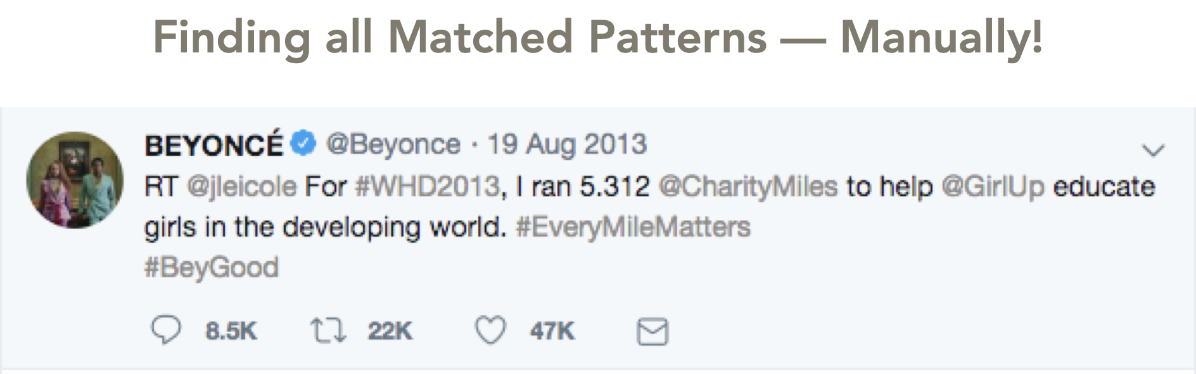
Regular Expressions
How would you extract the hashtag from this tweet?

Slide 61
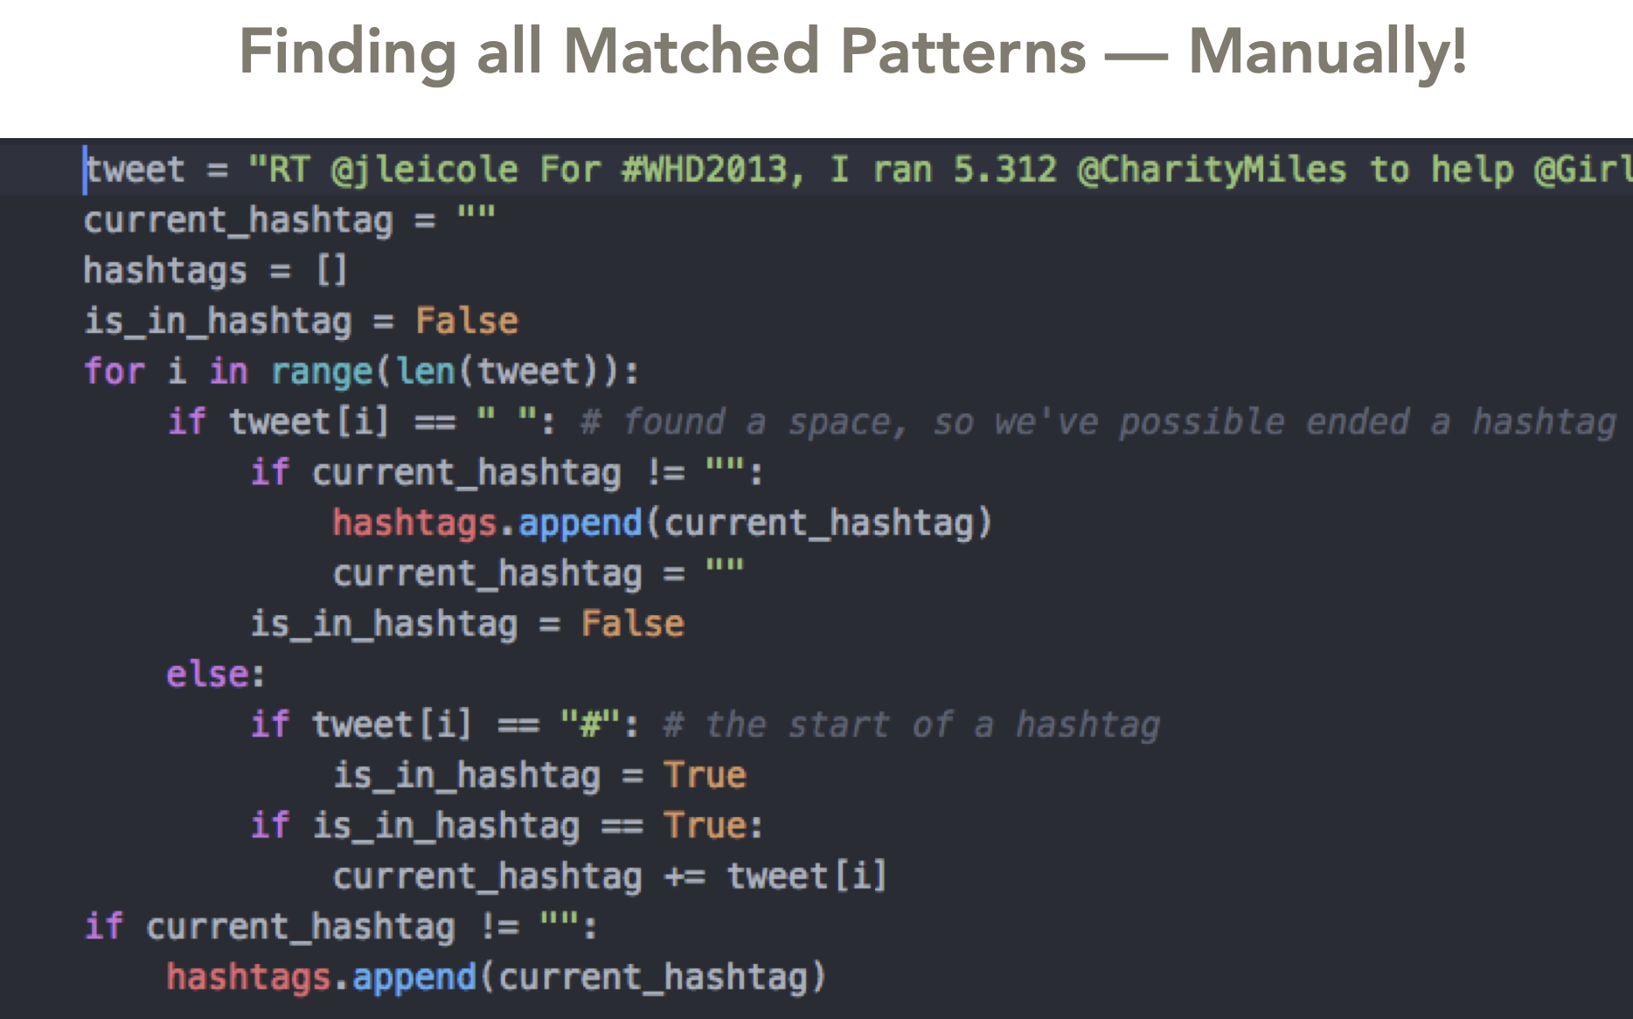
Regular Expressions

Slide 62
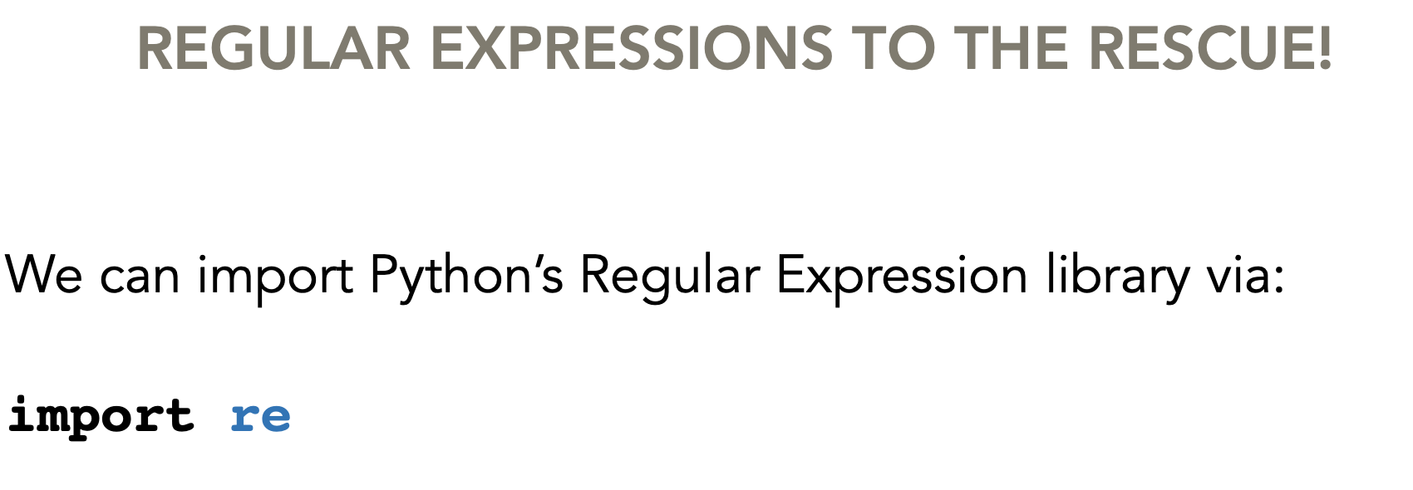
Regular Expressions

Slide 63
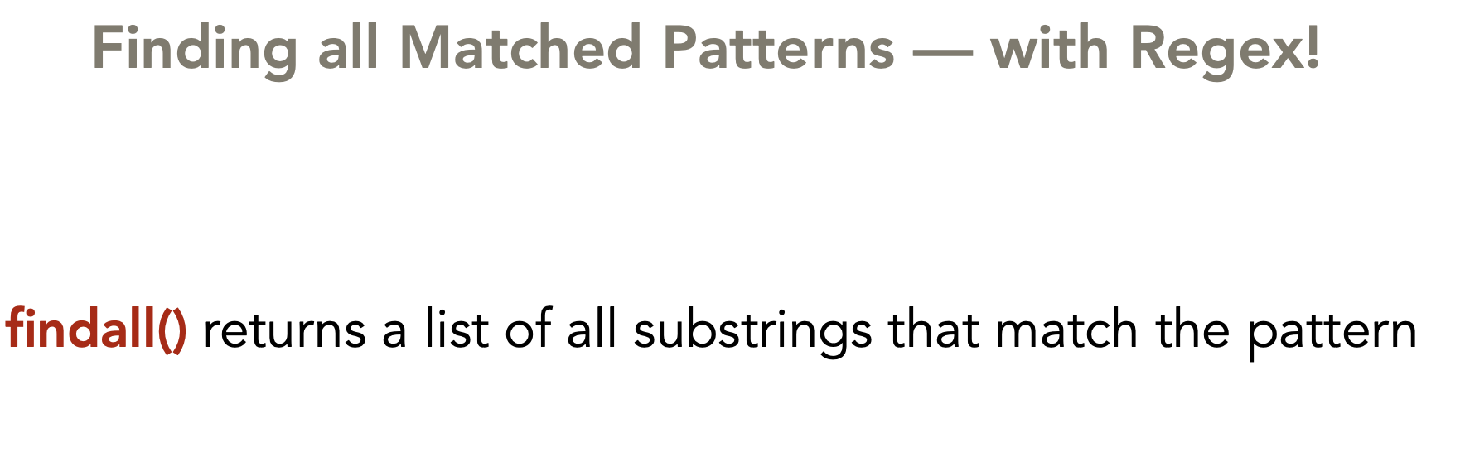
Regular Expressions

Slide 64
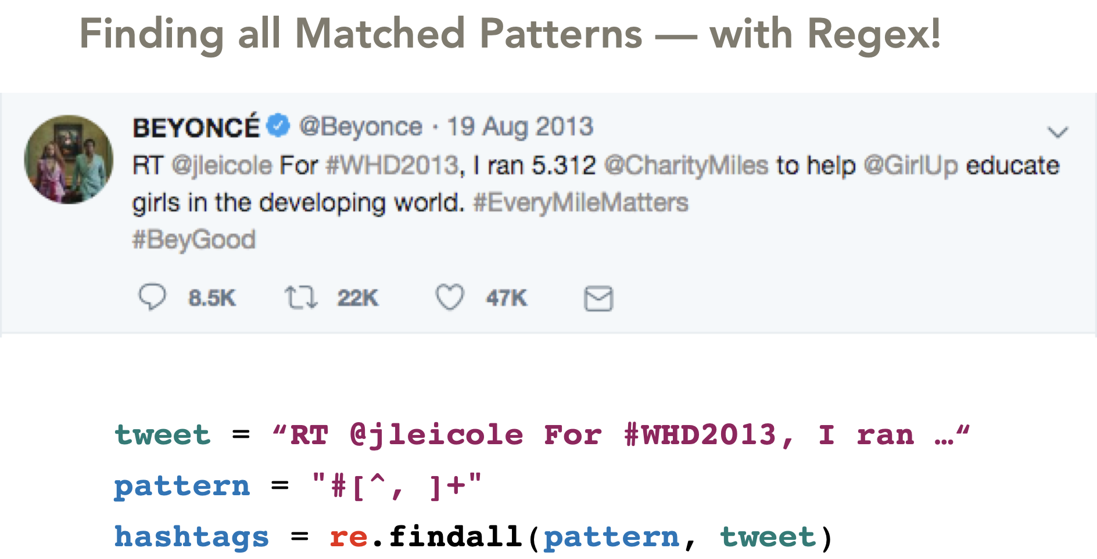
Regular Expressions

Slide 65
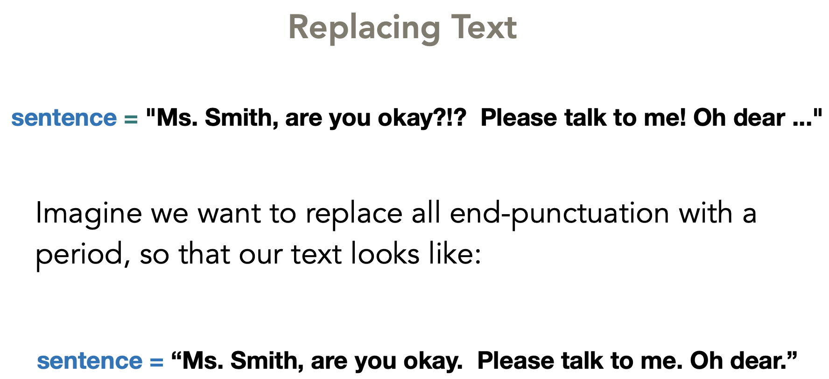
Regular Expressions

Slide 66
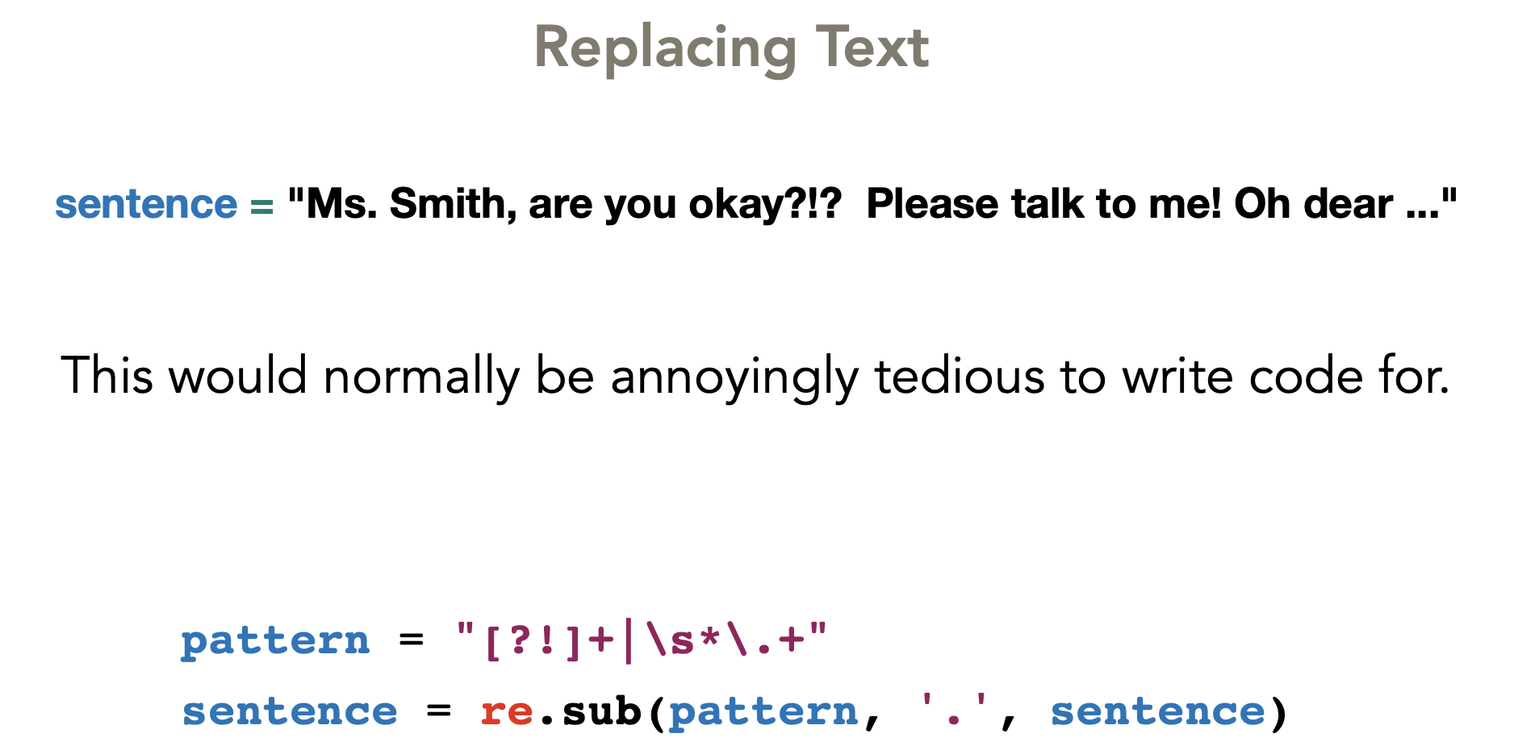
Regular Expressions

Slide 67
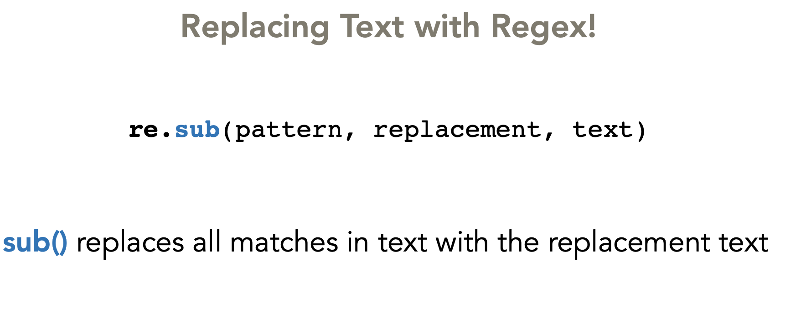
Regular Expressions

Slide 68
Regular Expressions
Patterns work by matching on:
specific characters (e.g., ‘z’) or
large categories of characters (e.g., all lowercased letters or all digits)

Slide 69
Regular Expressions
WORKED EXAMPLE:
“Code didn't work, no idea why…”

Slide 70
Regular Expressions
Specific Characters
text = “Code didn't work, no idea why…”
pattern = ‘a’
re.findall(pattern, text)
Output: a

Slide 71
Regular Expressions
Specific Characters
text = “Code didn't work, no idea why…”
pattern = ‘[aeiouy]’
re.findall(pattern, text)
The [ ] brackets denote “any of these characters”
Output: ['o', 'e', 'i', 'o', 'o', 'i', 'e', 'a', 'y']

Slide 72
Regular Expressions
Specific Characters
text = “Code didn't work, no idea why…”
pattern = ‘[a-z]’
re.findall(pattern, text)
The [ ] brackets denote “any of these characters”
Output: [‘o', 'd', 'e', 'd', 'i', 'd', 'n', 't', 'w', 'o', 'r', 'k', 'n’, 'o', 'i', 'd', 'e', 'a', 'w', 'h', 'y']

Slide 73
Regular Expressions
Specific Characters
text = “Code didn't work, no idea why…”
pattern = ‘[a-zA-Z]’
re.findall(pattern, text)
The [ ] brackets denote “any of these characters”
Output: ['C', 'o', 'd', 'e', 'd', 'i', 'd', 'n', 't', 'w', 'o', 'r', 'k’, 'n', 'o', 'i', 'd', 'e', 'a', 'w', 'h', 'y']

Slide 74
Regular Expressions
Repeated Characters
text = “Code didn't work, no idea why…”
pattern = ‘[a-zA-Z]+’
re.findall(pattern, text)
The + sign means 1 or more occurrences must appear (greedy approach of matching)
Output: ['Code', 'didn', 't', 'work', 'no', 'idea', 'why']

Slide 75
Regular Expressions
Repeated Characters
text = “Code didn't work, no idea why…”
pattern = ‘[a-zA-Z]*’
re.findall(pattern, text)
The * sign means 0 or more occurrences must appear
(greedy approach of matching)
Output: ['Code', '', 'didn', '', 't', '', 'work', '', '', 'no', ’’, 'idea’,'', 'why’, ’’ , ’’ , ’’ , ‘’]

Slide 76
Regular Expressions
Repeated Characters
Instead of matching on 0 or more or 1 or more occurrences, you can also specify an exact number of occurrences N with {N}

Slide 77
Regular Expressions
text = “555-123-1234, 33-555-123-5678”
pattern = ‘\d{3}-\d{3}-\d{4}’
re.findall(pattern, text)
\d{3} means exactly 3 single-digits in a row
Output: ['555-123-1234', '555-123-5678']

Slide 78
Regular Expressions
text = “555-123-1234, 33-555-123-5678”
pattern = ‘\d{1,3}-\d{3}-\d{3}-\d{4}’
re.findall(pattern, text)
What do you think this matches?

Slide 79
Regular Expressions
text = “555-123-1234, 33-555-123-5678”
pattern = ‘\d{1,3}-\d{3}-\d{3}-\d{4}’
re.findall(pattern, text)
Output: ['555-123-1234', '555-123-5678']

Slide 80
Regular Expressions
RegEx Syntax
\w Any alphanumeric character and underscore, equivalent to [a-zA-Z0-9_]
\s Matches any whitespace (spaces, tabs, line breaks)
\d Matches any digit character, equivalent to [0-9]

Slide 81
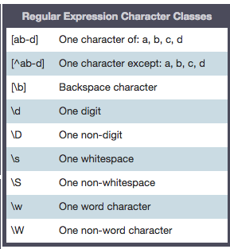
RegEx Syntax

Slide 82
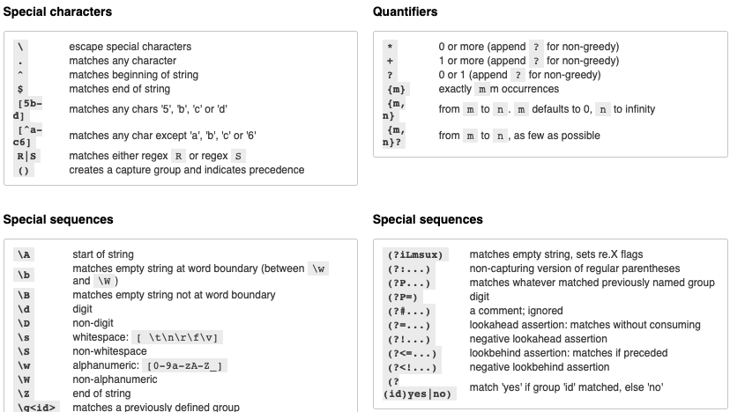
https://pythex.org/

Slide 83
Learning Objectives
Understand different types and formats of data
Be able to soundly select appropriate data
Have awareness of biases that exist
Be able to refine questions to suite your true inquiry
Understand how to parse text with regular expressions

Slide 84
BREAK-OUT ROOM TIME!

